Slide 1
FieldChartOCR
Extraction of Handwritten Charts and Tables
DD/MM/YYYY
Feature Name/Product
Your Company Name

Slide 2

Introduction
This presentation summarizes the FieldChartOCR project proposal, focusing on extracting and digitizing handwritten charts and tables. It addresses the challenges faced in manual chart digitization and outlines a novel solution. The goal is to provide a clear overview for supervisory-level stakeholders on project motivation, approach, and evaluation plans.
DD/MM/YYYY
Feature Name/Product
Your Company Name

Slide 3
01
Project Introduction

Slide 4
Project Name, Presenter, Date
FieldChartOCR: Extraction of Handwritten Charts and Tables
Presented by Chris Brechin
Date: November 18th, 2025
DD/MM/YYYY
Feature Name/Product
Your Company Name

Slide 5
Motivation and Problem Statement
Digitizing handwritten charts is difficult due to varied handwriting styles, inconsistent layouts, and noise in scanned images. Manual transcription is slow and error-prone, causing significant pain points for data accessibility and analysis. FieldChartOCR aims to automate this process, improving accuracy and efficiency in converting handwritten visual data into machine-readable formats.
DD/MM/YYYY
Feature Name/Product
Your Company Name

Slide 6
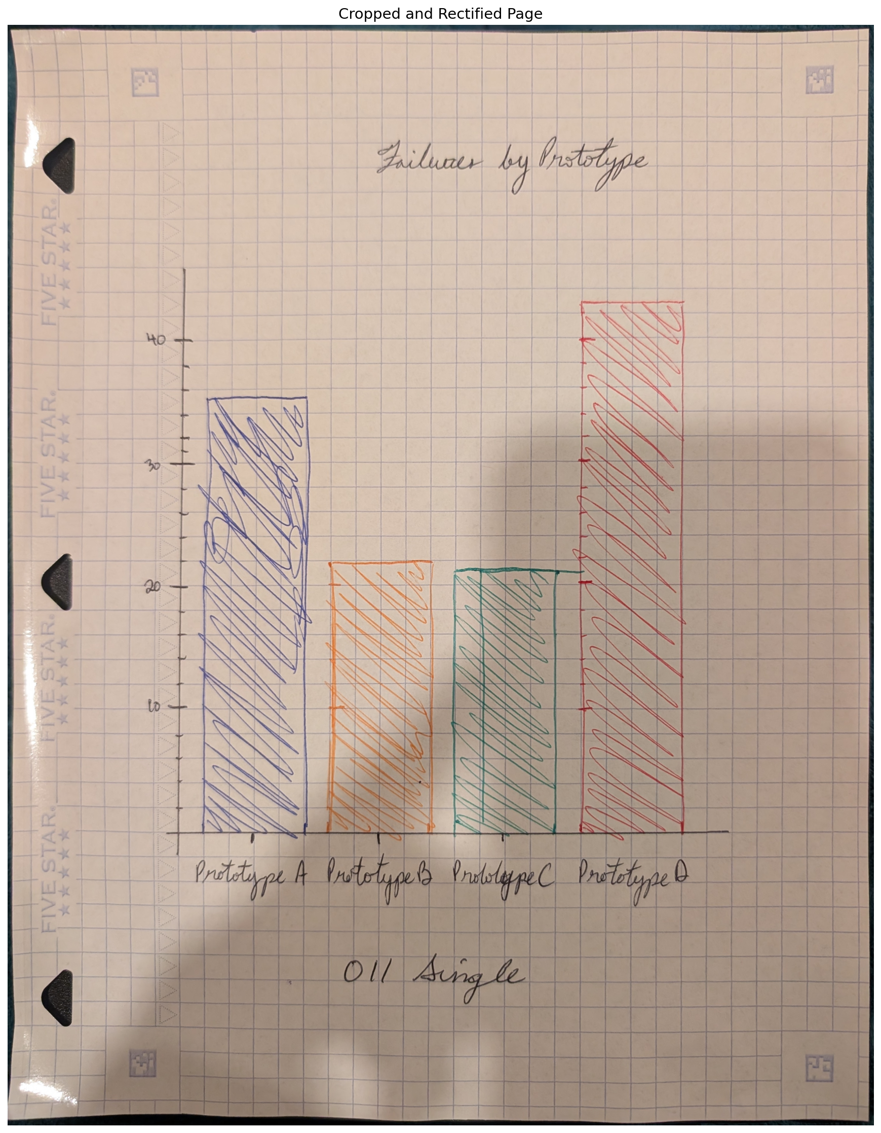
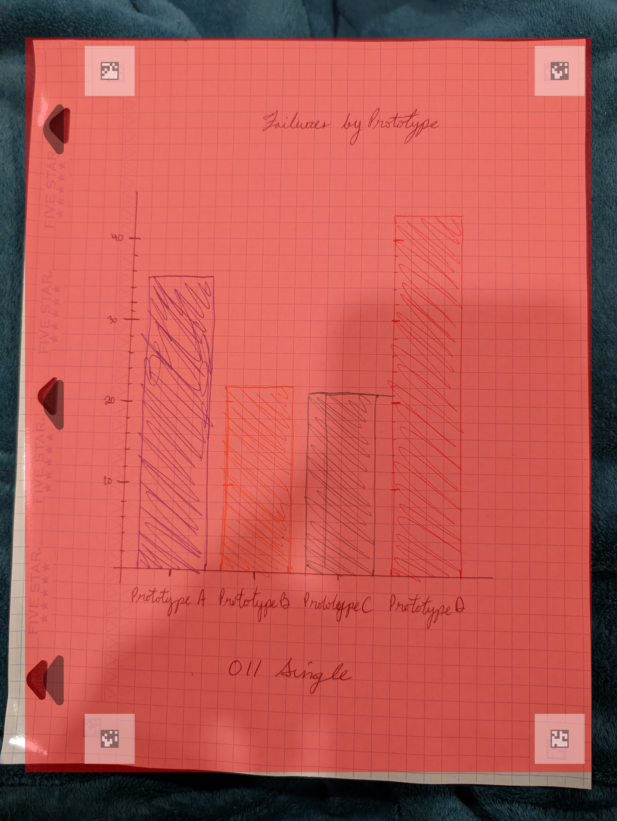
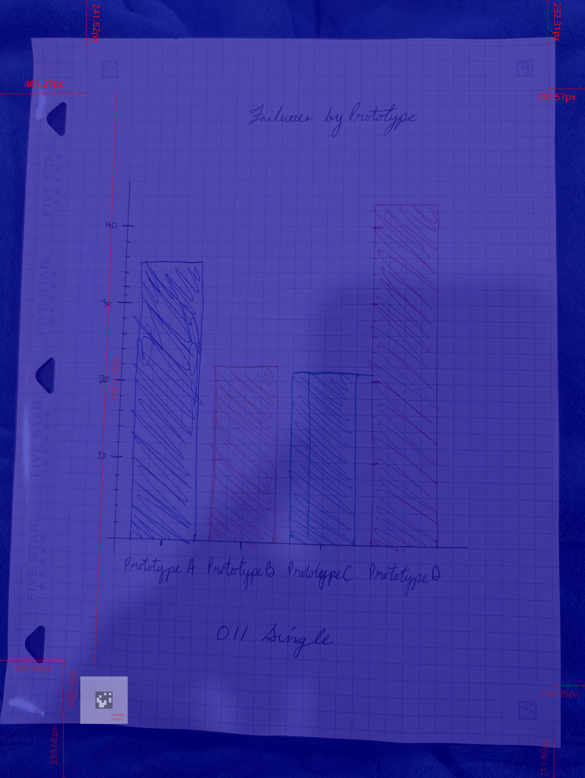
Key Challenges in Digitizing Handwritten Charts
Update
Handwritten charts are challenging to digitize due to inconsistent handwriting, diverse chart formats, and image noise. These factors lead to difficulties in automated recognition and interpretation. The lack of standardization increases error rates, making manual transcription time-consuming and costly. Addressing these challenges requires robust pre-processing, classification, and OCR techniques tailored specifically for handwritten data.
This project has been substantially more difficult than previously imagined. I have decided to limit the digitization efforts to only bar charts. This was done to allow me to build one pipeline for at least one kind of data.
Examples:
1. Coded Timesheet
2. Sparse, Coded Timesheet
3. Table with mixed, float and integer values
4. Table with mixed, string and integer values
5. Checklist
DD/MM/YYYY
Feature Name/Product
Your Company Name

Slide 7
02
Technical Approach and Planning

Slide 8
Overview of FieldChartOCR Solution
FieldChartOCR employs a modular approach combining preprocessing, classification, and detection models. It will integrate OCR tailored for handwriting, alongside semantic assembly modules that reconstruct charts and tables accurately. I aim to automate the extraction pipeline, significantly reducing manual effort while maintaining high accuracy in digitizing complex handwritten visual data.
Training
Validation
Photo Normalization
DD/MM/YYYY
Camera Images
Corresponding Digital Charts
Chart Type Classification
OCR
Comma Separated Lists with tabulated data
Element Recognition
Information Extraction

Slide 9
System Architecture and Processing Pipeline
The pipeline consists of four key stages:
1. preprocessing to enhance image quality;
2. classification to identify chart types;
3. detection and OCR to extract handwritten text and graphical elements; and
4. semantic assembly to organize extracted data into structured formats.
Each stage leverages machine learning models for the specific purposeses
Photo Normalization
Chart Type Classification
OCR
Element Recognition
Information Extraction
DD/MM/YYYY
Feature Name/Product
Your Company Name

Slide 10
Data Sources and Evaluation Metrics
Training
Validation
Data sources include annotated datasets of handwritten charts and synthetic data generated to augment training diversity. Success will be measured using classification F1 scores, detection accuracy, Character Error Rate (CER) for OCR, and runtime performance. These metrics will guide iterative improvements, ensuring the system meets practical usability and reliability standards.
DD/MM/YYYY
Camera Images
Corresponding Digital Charts
Comma Separated Lists with tabulated data
DD/MM/YYYY
Feature Name/Product
Your Company Name

Slide 11
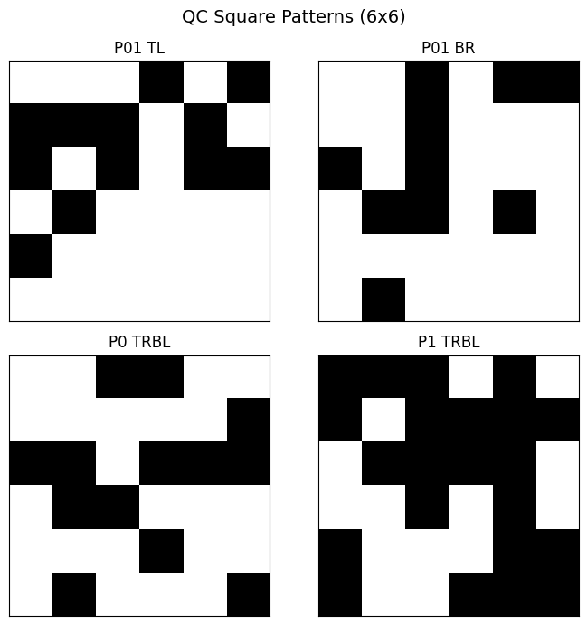
Page Corner Search Metric
Training
In the current step, I am trying to detect the edge of the page using quick calibration squares in the specialized paper I purchased.
The QC squares are featured left:
Front and Back Top Left are the same
- Front and Back Bottom Right are the same
- Front Page Top Right and Bottom Left are the same
- Back Page Top Right and Bottom Left are the same
DD/MM/YYYY
DD/MM/YYYY
Feature Name/Product
Your Company Name

Slide 12
Conclusions
I am currently working on the calibration of page detection so that I can normalize the image and crop to the content. The normalization step is important because it helps the next step detect the sizing of bar charts.
DD/MM/YYYY
Feature Name/Product
Your Company Name

Slide 13
Thanks!
Do you have any questions?
chris@brechin.services
https://brechin.services
Feature Name/Product

